Slide 1

CS 360 Programming Languages Exceptions and Threads

Slide 2
Exceptions
What do you do when a program encounters an anomalous, unusual event?
Try to open a file and it's not there
Try to convert a string to an integer and it's not a valid integer
Try to dereference a pointer and it's null

Slide 3
Exceptions
You could
crash the program
Not a great idea
return an error code
But what if all return values are "meaningful?"
force the user to manually check the condition before taking the action that might cause problems
More work for the programmer

Slide 4

Exceptions
Java (and other languages) choose to "throw an exception."

Slide 5
Exceptions
An Exception is an encapsulation of a problem that occurred while your program was running.
Exceptions allow the programmer to separate the logic of the exceptional situation itself from what to do about it.
The other ways usually force you to couple together the code that generated the error with the code that handles the error situation.

Slide 6


Exceptions
When an exceptional situation occurs, your code can choose to "throw an exception."
When this happens, another piece of code must "catch the exception."

Slide 7
try {
Scanner sc = new Scanner(new File("data.txt"));
// read data from the scanner…
}
catch (FileNotFoundException e) {
System.err.println("Couldn't open file.");
}
Any code that has the ability to throw an exception should be placed inside a try block.
Here, the Scanner constructor may throw an exception if it can't find data.txt
The catch block afterwards is the error handler code.

Slide 8
try {
Scanner sc = new Scanner(new File("data.txt"));
// read data from the scanner…
}
catch (FileNotFoundException e) {
System.err.println("Couldn't open file.");
}
If the code in the try block doesn't throw an exception, the catch block is skipped.
If the code in the try block does throw an exception, as soon as the exception happens, the catch block starts running. After it finishes, program continues with whatever is after the catch block.
Therefore you can recover from errors gracefully.
Error handling logic is separated from the "normal program" logic.

Slide 9
Methods that have the ability to throw exceptions must declare what exceptions are possible.
public Scanner(File source) throws FileNotFoundException {
...
}
Java API tells you which methods throw which exceptions.
Code will not compile without proper try/catch blocks.

Slide 10
Code can further decouple the "throwing" logic from the "catching" logic:
void methodA() throws SomeException {
// code here that may throw SomeException
}
void methodB() throws SomeException {
methodA()
}
void methodC() {
try { methodB(); }
catch (SomeException e) { … }
If a method wants to call some code that may throw an exception, the method must either handle it (with a catch block) or pass it back to the calling method (add "throws" to the declaration line).

Slide 11
Call Stack
A throws an exception.
Java looks for a catch block in A.
methodA()
There is no catch block in A. Java looks for a catch block in B.
methodB()
methodC()
There is no catch block in B. Java looks for a catch block in C.
main()

Slide 12
"Normal" Exceptions
Inherit from class Exception. Must be caught with a try block somewhere.
Runtime Exceptions
Inherit from class RuntimeException. Do not have to be caught.
DivideByZeroException, IndexOutOfboundsException, NullPointerException.
Errors
Inherit from class Error. Do not have to be caught because they indicate something a reasonable application probably can't recover from anyway (e.g., out of memory, stack overflow).

Slide 13
Takeaway
There are some methods that force you to write error-handling code. Won't compile without the try-catch.
Wrap the error-causing code in a try block (can wrap as much code as you want), and then put a catch block and try to do something intelligent in it (can be as simple as printing a message.)

Slide 14
More advanced stuff
Writing your own Exception classes
Writing your own methods that throw Exceptions (you can also throw exceptions that come with Java)
Beyond the scope of this class; consult a Java book; won't be necessary for projects or exams.
C++ also has exceptions; other languages too.

Slide 15
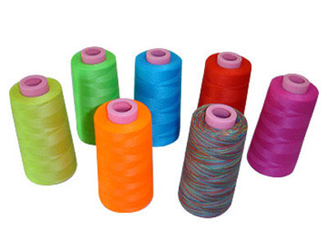
Threads

Slide 16
Most programs you write do one thing at a time.
Execution proceeds in a linear fashion, where the previous command always completes before the next one starts.
Sometimes we need to write programs that do multiple things at once.

Slide 17
Examples
Display a loading animation while accessing a big file.
e.g., web browsers
Handling requests in a client-server application.
e.g., web servers
Monitoring some situation in the background while letting the program do other things.
e.g., your email application
Games, games, games (and other GUI stuff)
Separate threads to handle information coming from keyboard, mouse, network.

Slide 18
A single CPU really can't do multiple things at once.
If you have multiple CPUs, OK.
Simulated by switching back and forth between tasks really quickly.

Slide 19
Processes vs threads
A process is a self-contained execution environment.
Process is often synonymous with "program" or "application" but not always.
Most importantly, each process has its own memory space.
Processes can communicate with each other through interprocess communication (IPC) [see networking class]

Slide 20
Processes vs threads
A thread is an execution environment within a process.
Within a process, there can be multiple threads, and they all share the same memory space.
Threads communicate with each other through variables (memory is shared, so variable are shared among threads).
By default, all programs are single-threaded.
These are the kinds of programs you've been writing so far.

Slide 21
Java Threads
Every thread is associated with a Thread object.
The Thread class has a single method that you will override: public void run()
The code inside this method defines what the thread will do.
To start the thread, call the start() method.
You never directly call run() yourself.

Slide 22
ThreadEx1, ThreadEx2, CountingEx
Notes:
examples 1 and 2, plus counting

Slide 23
Takeaway
A call to start() returns immediately.
The code in run() then starts running in a thread parallel to your main program.
rest of main()
print message that
both threads have started
t1's run()
print 0
print 1
print 2
print 3
…
t2's run()
print 0
print 1
print 2
print 3
…
Notes:
order is enforced within a thread, but not between threads

Slide 24
Sleeping
Threads can go to sleep, which pauses that thread for a certain amount of time.
During that time, the CPU will only deal with other threads.
After the time is elapsed, the thread wakes up and continues.

Slide 25
Good sleep
System.out.println("Falling asleep!")
try
{
// goes to sleep for one second
Thread.sleep(1000)
} catch (InterruptedException e) { }
System.out.println("Now I'm awake!")

Slide 26
Bad sleep
int start = System.currentTimeMillis()
int finish = start + 1000;
while (System.currentTimeMillis() < finish)
{
}

Slide 27
InterruptedException
Some thread methods throw InterruptedException, which must be caught.
You can decide what to do with it.
Fine to ignore it (for this course).

Slide 28
Join
Also common to want to pause execution of a thread until another thread finishes.
If t is a thread object, you can call t.join() This will pause the current thread (a la sleep()) but will wake up as soon as t finishes.
Example: CountingJoin

Slide 29
So far, threads are easy!

Slide 30

So far, threads are easy!
Where threads become hard is when they start sharing variables.

Slide 31
Imagine two ATMs and two people who have a shared account. The account has $20.
Both people go up to two different ATMs at the same time. Both try to withdraw $20 simultaneously.
void withdraw(int amount) {
if (balance >= amount) balance -= amount;
}

Slide 32
balance >= amount has multiple steps:
Retrieve the current value of balance.
Retrieve the current value of amount.
Compare those two values.

Slide 33
balance >= amount has multiple steps:
Retrieve the current value of balance.
Retrieve the current value of amount.
Compare those two values.
ATM 1: Retrieve current balance (= 20)
ATM 2: Retrieve current balance (= 20)
ATM 1: Retrieve current amount (= 20)
ATM 2: Retrieve current amount (= 20)
ATM 1: Compare => true
ATM 2: Compare => true
Both ATMs dispense cash!

Slide 34
So it appears we can withdraw $40 from a $20 balance!
And then our balance would be negative!
But no, it's much, much worse.

Slide 35
balance -= amount has multiple steps:
Retrieve the current value of balance.
Retrieve the current value of amount.
Subtract, put result in balance.

Slide 36
balance -= amount has multiple steps:
Retrieve the current value of balance.
Retrieve the current value of amount.
Subtract, put result in balance.
ATM 1: Retrieve current balance (= 20)
ATM 2: Retrieve current balance (= 20)
ATM 1: Retrieve current amount (= 20)
ATM 2: Retrieve current amount (= 20)
ATM 1: Subtract => 0 => store 0 in balance
ATM 2: Subtract => 0 => store 0 in balance
Both ATMs dispense cash!

Slide 37
Pathological example; very possible that nothing bad will happen at all.
And then you don't notice anything bad happening until your bank starts mysteriously losing money ever so often…
Called a race condition.
Race condition: situation where result is dependent on the sequence or timing of other, uncontrollable events.
This specific condition is a memory inconsistency error: Happens when different threads have inconsistent views of what should be the same information.

Slide 38
Demo
Ex: Bank
Ex: Bank2 (race)

Slide 39
Solution: locks
Every object has a lock associated with it.
Sometimes called an intrinsic lock or monitor lock.
Note: separate locks for each instance of an object, not one per class.
A lock can be owned by at most one thread.
Sometimes owned by no threads.
Can be used to prevent race conditions by forcing a thread to own the lock for a certain object before running code that needs exclusive access to that object's fields.

Slide 40
Locks
Locks are not objects themselves.
Access to them is controlled through blocks of code that are declared as "synchronized."

Slide 41
Locks
When a thread T1 attempts to enter a block of code that is synchronized on object x, T1 tries to acquire x's lock.
If x's lock is available, then T1 acquires the lock and runs the block of code.
If x's lock is not available (b/c it is owned by another thread), then the scheduler switches to a different thread. At some point, the scheduler will switch back to T1 and try again to acquire the lock.
When T1 leaves the synchronized block, x's lock is released.
Guaranteed within a synchronized block that at most one thread owns x's lock.

Slide 42
Locks
First kind of synch block: synchronized method.
Use the word synchronized after the return type in the declaration line of a method.
If method() is synchronized , when a thread calls x.method(), the thread will try to acquire x's lock.

Slide 43
Class C {
synchronized void methodA() { }
synchronized void methodB() { }
}
in main:
C x = new C(), y = new C();
// two threads start simultaneously
Thread 1: x.methodA() // 1 acquires x's lock. // 1 starts running methodA // 1 finishes methodA // 1 releases x's lock | Thread 2: x.methodA() // 2 fails to acquire x's lock // 2 acquires x's lock // 2 starts running methodA // 2 finishes methodA // 2 releases x's lock

Slide 44
Class C {
synchronized void methodA() { }
synchronized void methodB() { }
}
in main:
C x = new C(), y = new C();
// two threads start simultaneously
Thread 1: x.methodA() // 1 acquires x's lock. // 1 starts running methodA // 1 finishes methodA // 1 releases x's lock | Thread 2: x.methodB() // 2 fails to acquire x's lock // 2 acquires x's lock // 2 starts running methodB // 2 finishes methodB // 2 releases x's lock

Slide 45
Class C {
synchronized void methodA() { }
synchronized void methodB() { }
}
in main:
C x = new C(), y = new C();
// two threads start simultaneously
Thread 1: x.methodA() // 1 acquires x's lock. // 1 starts running methodA // 1 finishes methodA // 1 releases x's lock | Thread 2: y.methodA() // 2 acquires y's lock. // 2 starts running methodA // 2 finishes methodA // 2 releases y's lock

Slide 46
Locks
If T1 tries to enter a synchronized block for an object x, and already owns owns x's lock, this is allowed.
In other words, if you try to acquire a lock you already own, nothing bad happens.
Happens when synchronized blocks call other functions that have synchronized blocks.

Slide 47
Locks
When a thread runs a synchronized block, it does not guarantee that the thread will not be interrupted or interwoven with other threads.
Common misconception: synchronized == atomic.
Scheduler can still stop a thread T1 in the middle of a synchronized block and switch to a different thread T2.
However, if T2 happens to need a lock owned by T1, then the scheduler will have to immediately switch to a different thread.

Slide 48
Fix bank account
Fix the race condition in bank2.
Notes:
add synch to deposit, withdraw

Slide 49
Locks
Sometimes a synchronized method isn't the right solution.
A synchronized block inside a class C always acquires the lock for an object of class C.
What if you need to acquire a lock for a different object?
Solution: Java allows you to synchronize on any object you'd like.
Notes:
add synch to deposit, withdraw

Slide 50
You may have a synchronized blocks (inside any method):
class C { public void method() { synchronized (y) { … } }
in main() C x = new C(); x.method()
When a thread tries to call x.method(), the thread will try to acquire the lock for object y, not x.
This idiom is common when you using other people's code that isn't synchronized, but you'd like it to be.

Slide 51
Fix bank account
What if we didn't write the BankAccount class and therefore we can't change it? How could we eliminate the race condition?
Notes:
put a synchronized block in DepositorThread, inside the for loop, sync'ed on acc.

Slide 52
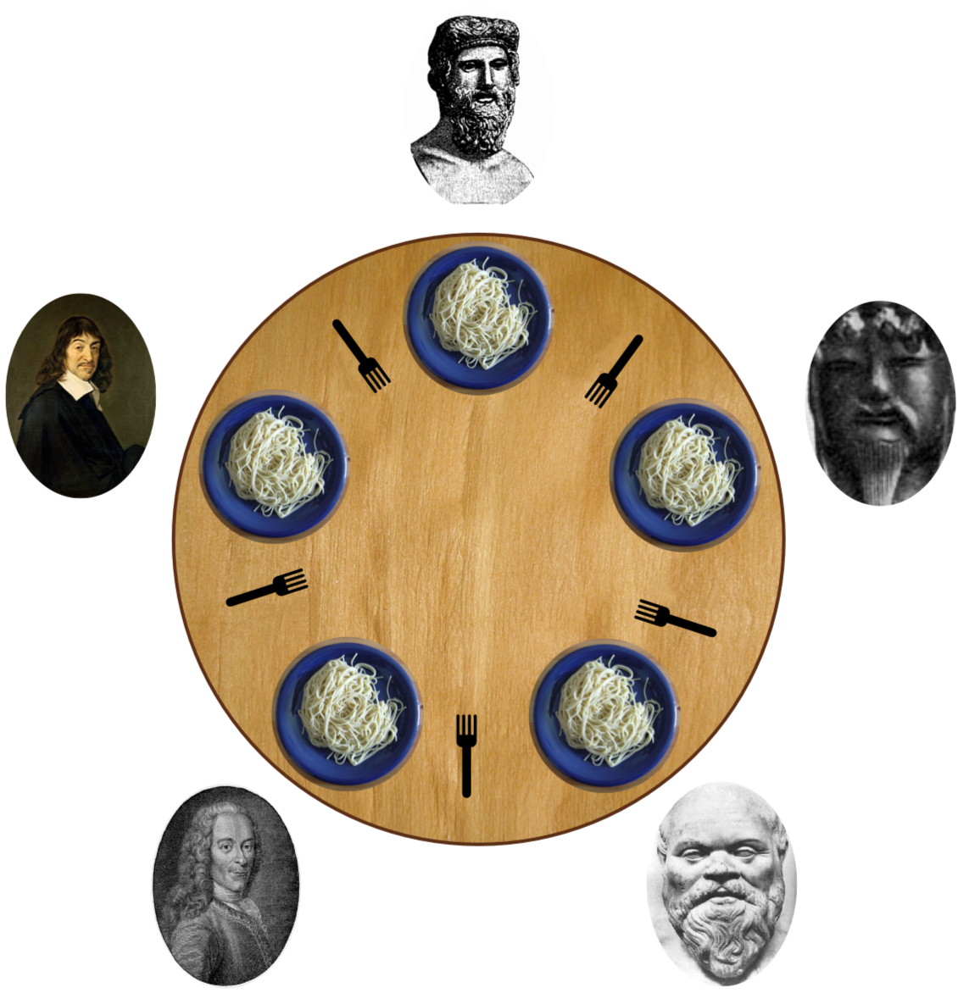

Slide 53
Assume we have five Fork instances.
Inside each philosopher's run method:
synchronized (fork to the left) {
synchronized (fork to the right) {
// eat spaghetti
}
}

Slide 54

Deadlock
https://www.youtube.com/watch?v=R7M97B7bLZU
Notes:
Deadlock is a German melodic death metal band from Schwarzenfeld, Bavaria, Germany.

Slide 55
Remedies
Resource hierarchy: assign numbers to the forks; must always request lower-numbered fork first.
Central arbiter: Write a waiter class that manages all the forks. The waiter will never give out forks in a way that will allow deadlock.

Slide 56
Other issues
Starvation
A thread is consistently denied access to a shared resource by other "greedy" threads.
Example: synch methods that take a long time to run and are called frequently.
Livelock
Thread A takes some action in response to another Thread B in attempt to avoid a problem.
Thread B then response to A's action.
Back and forth: neither thread is deadlocked, but they are too busy responding to each other to get anything else done.

Slide 57
Coordination
Imagine a restaurant with a chef and a waiter.
The chef's job is to prepare food and place the food in the pickup area.
The pickup area can only hold one order at a time.
The waiter's job is to take the food from the pickup area to the tables.

Slide 58
Class PickupArea models the waiting area for an order. Holds the order number as an int.
Class Chef is a thread that when started, will cook ten orders back-to-back (sleeping randomly between them) and place them in the waiting area.
Class Waiter is a thread that when started, will pick up ten orders from the waiting area and serve them (sleeping randomly between them).

Slide 59
Show restaurant

Slide 60
Waiter doesn't wait for chef to cook meals before serving them.
The waiter might serve the same meal over and over, or sometimes will serve order 0, which means there is no meal!
Chef doesn't wait for the pickup area to be empty before cooking the next meal.
The chef might cook multiple orders and put them all in the waiting area back to back, overwriting the existing order that was already there.

Slide 61
2 part solution
Part A:
Synchronize on the pickup area so that the waiter and chef don't step on each other's toes.
Part B:
Have the two threads communicate about when orders are ready.

Slide 62
Solution: Guarded blocks
A guarded block is a block of code that cannot execute until a condition is true.
Chef should not cook a new order until the pickup area is free.
Waiter should not pickup an order unless there is one waiting in the pickup area.

Slide 63
In Chef.run():
while (pickupArea.orderNumber > 0) { }
In Waiter.run():
while (pickupArea.orderNumber == 0) { } Let's try. (Show restaurant1.5)

Slide 64
Busy waiting is bad, mm'kay?
Never wait on a condition with an empty while loop.
If a thread cannot continue until a condition is true, we need to tell the thread to wait without wasting CPU cycles.

Slide 65
Every object has two methods, called wait() and notifyAll().
Whenever a thread holds a lock for an object x, the thread may call x.wait() and/or x.notifyAll().
x.wait() suspends the current thread and releases x's lock until it receives a wakeup call from x.notifyAll(). The CPU scheduler will not attempt to resume this thread until it is woken up with x.notifyAll().
x.notifyAll() wakes up all the threads that are waiting on object x. All the awakened threads then are available to pick up wherever they left off when they each called x.wait(). Each thread will automatically attempt to reacquire x's lock before resuming.

Slide 66
Most common idiom:
T1: [inside synch block for x]
while (!condition) { x.wait(); }
T2: [inside synch block for x]
condition = true; x.notifyAll();

Slide 67
Try it out

Slide 68
Why does this work?
If T1 holds x's lock and calls x.wait(), then x's lock is released!
Therefore, another thread T2 can acquire x's lock to fix the condition that T1 is waiting on.
Busy waits and sleep()s don't release locks, so our first fix for the restaurant was stuck forever busy waiting.

Slide 69
Bank account vs Restaurant
BankAccount did not need wait/notifyAll because if we tried to withdraw more money than we had, the withdraw() method simply failed.
wait/notifyAll are used in situations where failure is not an option --- you want your code to keep "retrying" until the situation is rectified.

Slide 70
Bank account vs Restaurant
Chef & Waiter needs wait/notifyAll because:
We don't want the Chef to lose an order (fail) if there's already an order waiting to be picked up (aka when the Chef is ahead of the Waiter)
We don't want the Waiter to pick up the same order twice (fail) if there's not a new order waiting to be picked up (aka when the Waiter is ahead of the Chef).

